Slide 1
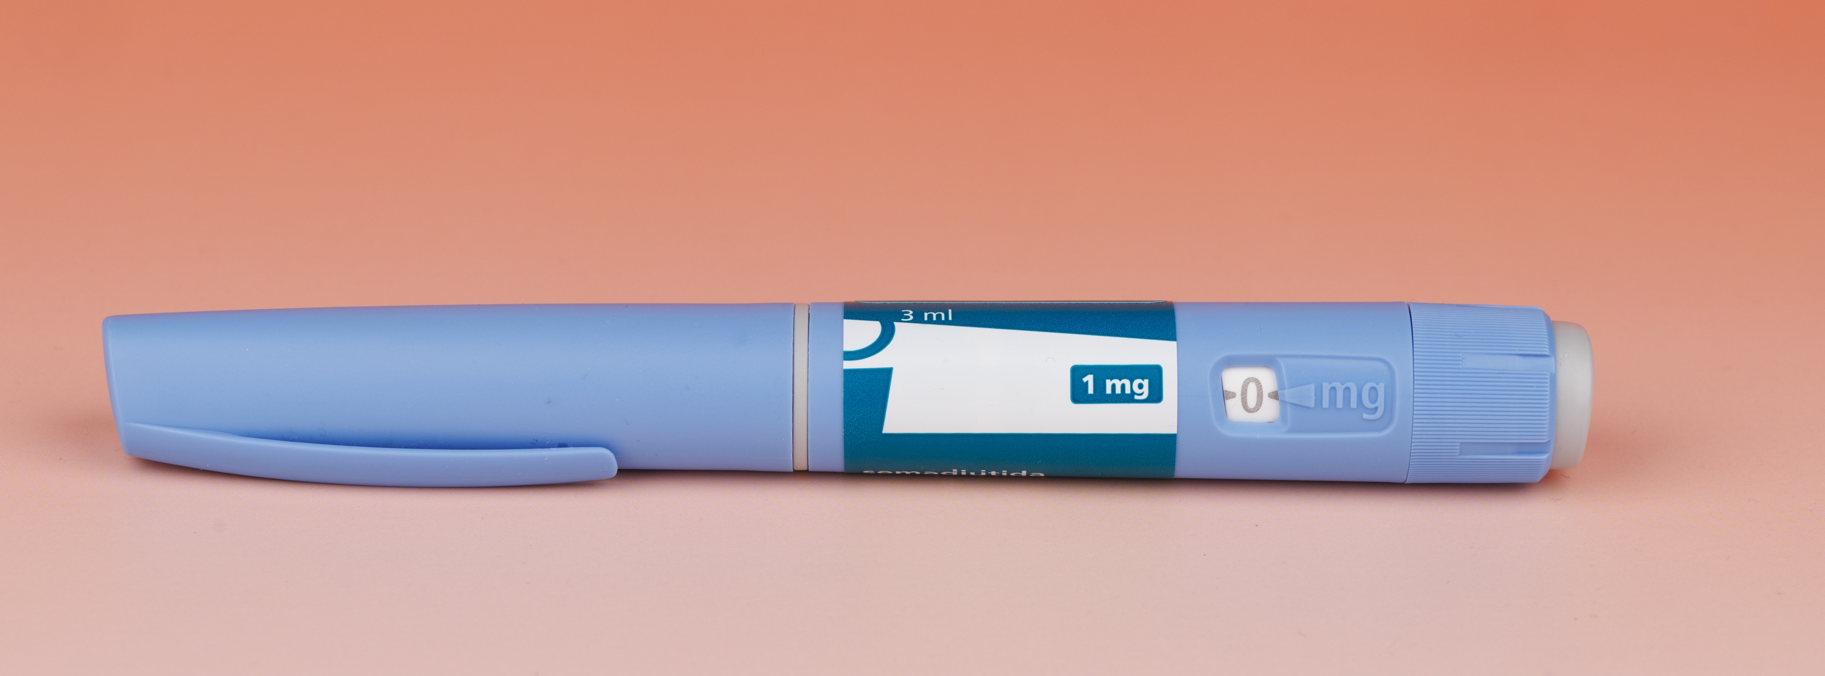
The GLP-1 effect: Rethinking demand spaces is no longer optional

